Slide 1
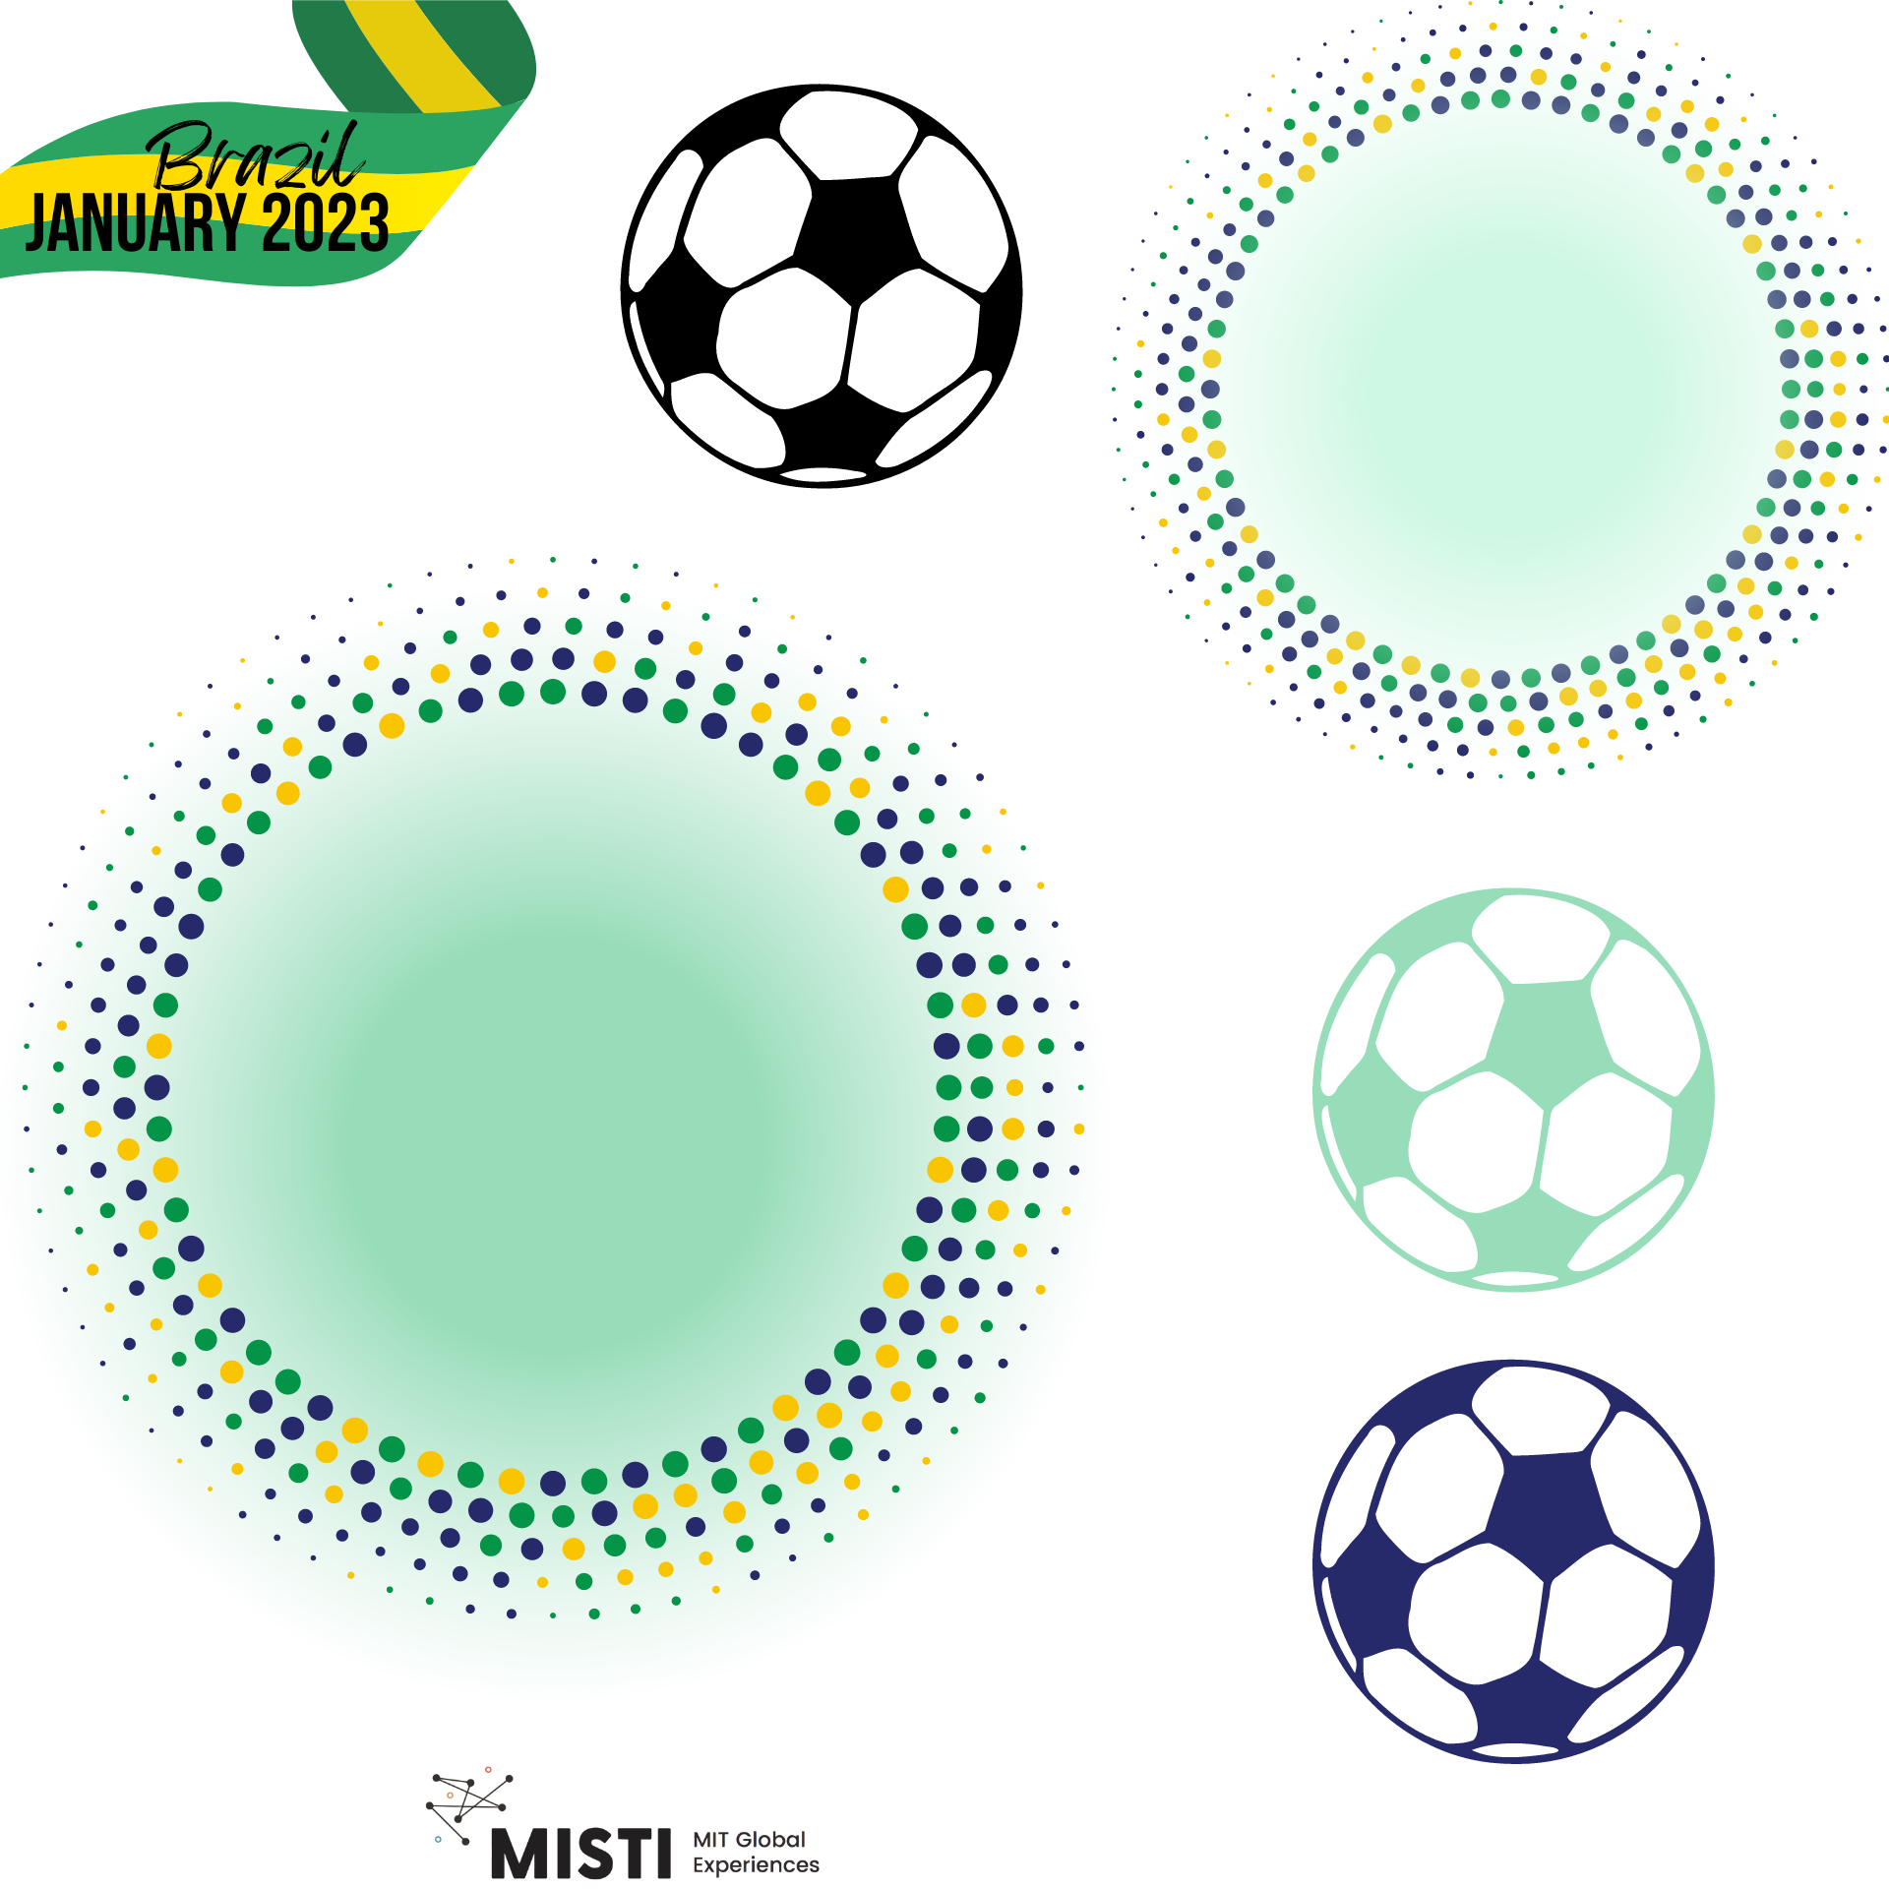
How materials and physical therapist can be used to solve/fix common accidents in soccer

Slide 2
What are the most common injuries in football?
Ankle sprain
Calf strain
Foot fracture
Patella bursitis
Knee sprain
Collarbone fracture
Image of most common football (soccer) injuries
Notes:
https://www.nike.com/a/common-soccer-injuries

Slide 3
How we can use materials for soccer injury?
Surgery
Physical therapy
Soccer shoes for stabilization

Slide 4
Surgery
Sometimes your injury is bad and you need surgery :(
Robotic Surgery
Different tools (laparoscopic surgery – camera needs to be really small to fit inside of you)
Image of robotic surgery tool, other tools for surgery

Slide 5
Physical Therapy
This is how most people recover from injury
Ex: If you injure your knee and can’t walk on one leg for a few months, you need to re-learn how to walk correctly without limping
Image of PT gym, training/strengthening elastic bands

Slide 6
Soccer Shoes for Stability
Men and women have different shoes – women more likely to get knee injuries
Nike had a unisex shoe that got a lot of heat for this reason
Spikes on soccer shoe
etc

